Slide 1


Long Term Unemployment from January 2005 to February 2015
By Kristin Scully

Slide 2
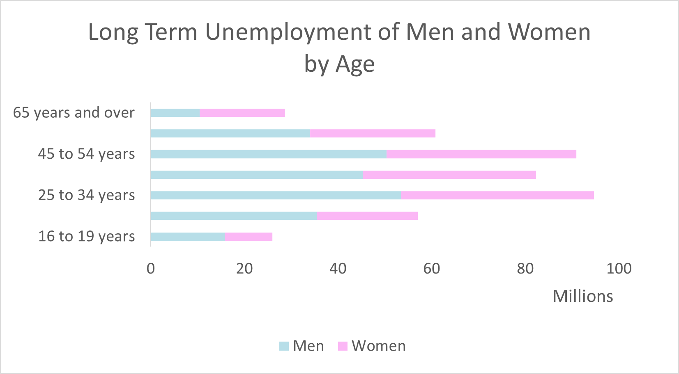
Men vs Women by Age Group

Slide 3
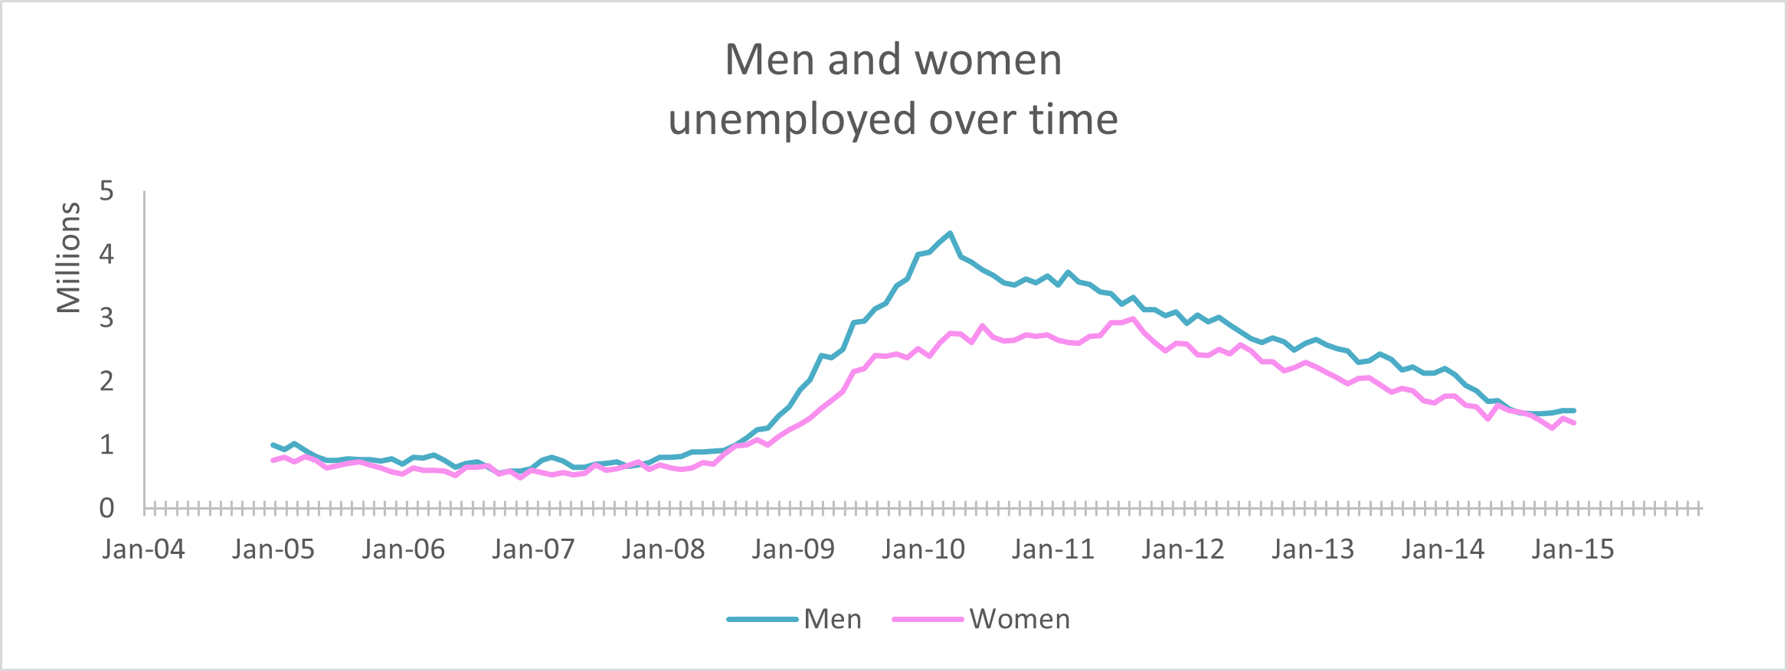
Men vs Women over time

Slide 4
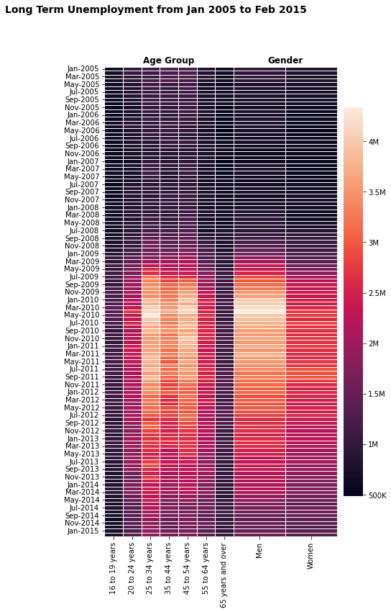
Men, Women, and Age Groups Over Time

Slide 5
Conclusion

Slide 6
References

